Slide 1
Game Development 2B
Introduction

Slide 2

Welcome to game development 2B
It’s a hell of a lot like last semester
A lot of learning by doing
Your first major project that produces an actual result
Do not just try to phone this semester in
You’re making a narrative game!

Slide 3
Where we are as a class
Covid was rough
I’m not sure where everyone is really at because lack of deadlines
Halfway through the degree, so dream bigger!
Some of you played last semester quite safe
You need to start developing finished products
I recommend, if you’re struggling with basics to attend 1B online classes

Slide 4
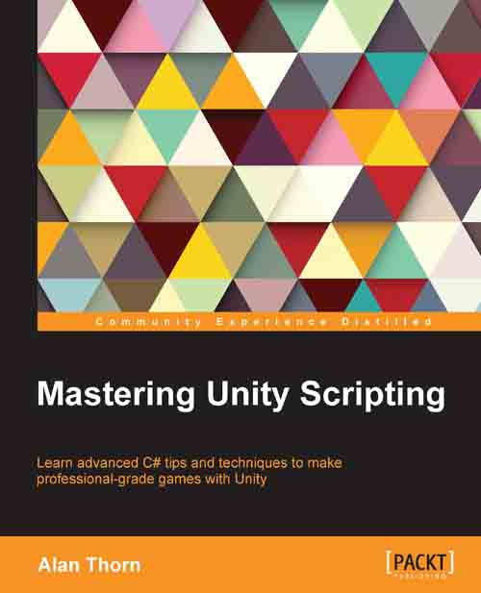
Prescribed textbook
Mastering Unity Scripting – Alan Thorn
You guys already have a copy
Everything for the module is otherwise on VegaLearn (Assignments, Handins, Lecture Slides)
Learn Guide
Other Resources

Slide 5
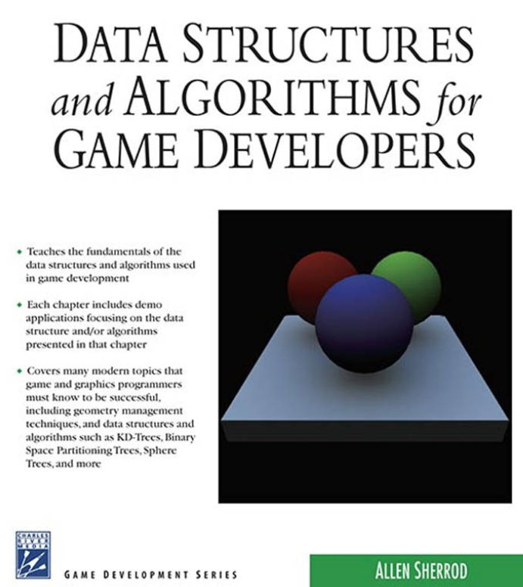
Other prescribed textbook
Data Structures and Algorithms for Game Developers – A Sherrod
This is for the data structures we’ll be doing
I’ll probably teach you this in a relative vacuum as these are programming language agnostic
I will most likely make you write your own implementations

Slide 6

Other prescribed textbook
Head First Design Patterns – Freeman, Freeman and Sierra
Also free on Learn
This is for design patterns
I’ll probably teach you this in a relative vacuum as these are programming language agnostic
I will most likely make you write your own implementations

Slide 7
A word on textbooks
These textbooks are all really useful as additional texts
Not just for what I teach in class, but also to refer back to later
We don’t have time to go in depth about everything
It’s really useful to go through these books and earmark things you might use one day
You’re halfway through your studies – any additional information will become useful

Slide 8
ice
ICE Activities: 4-6 – 10%
Homework
All activities must be submitted
Only half of them are marked
These contribute 5%
The other 5% (unmarked half) are “completion” ICEs
You won’t know which is which

Slide 9
Ice types
Implementing design patterns
Implementing data structures
POE game progress

Slide 10
Assessment Criteria
Portfolio of Evidence – 90%
Task 1: Basic story, conversation structures and LinkedList – 25%
Task 2: Parsing, puzzles and inventory – 30%
All out of 100
Separate Hand In Dates for Each Section
POE: Final Game with Dialogue Graphs – 35%

Slide 11
POE Due dates
14 Sept 2020, 17:00 PM
Task 1: Linked Lists and Dialogue
23 October 2020, 17:00 PM
Task 2: Parsing, Inventory and Puzzles
POE: Dialogue Graphs, Final Game
TBA, mid/end November 2020, 17:00 PM

Slide 12
Pass/fail/distinction criteria
You need 50% CASS to pass the module
75% = distinction
Resubmit if CASS <= 40% && POE >= 30%
< 50% CASS = fail, redo module

Slide 13
Module overview
3 Learning Units
1
Each Learning Unit is packed with stuff
2

Slide 14
Learning unit 1
Algorithmic Complexity
Generics
Abstract Data Structures
Linked Lists
Hash Tables
Stacks
Queues
Trees
Graphs
Design Patterns
Factory
Decorator
Template

Slide 15
Learning unit 2
NavMeshes
Animation States
State Machines to control movement and animation states

Slide 16
Learning unit 3
Unity Prototyping
Twine Prototyping
Testing in Unity

Slide 17
Module approach
Lots of content to get through
Especially the earlier sections that are very computer science heavy
Later sections are a bit more flexible and might change slightly depending on how the semester goes and what other problems need solving

